Slide 1

Introduction to Machine Learning
Machine learning is a field of artificial intelligence that enables computers to learn and improve from experience without being explicitly programmed. It involves developing algorithms and statistical models that allow systems to perform specific tasks effectively.

Slide 2
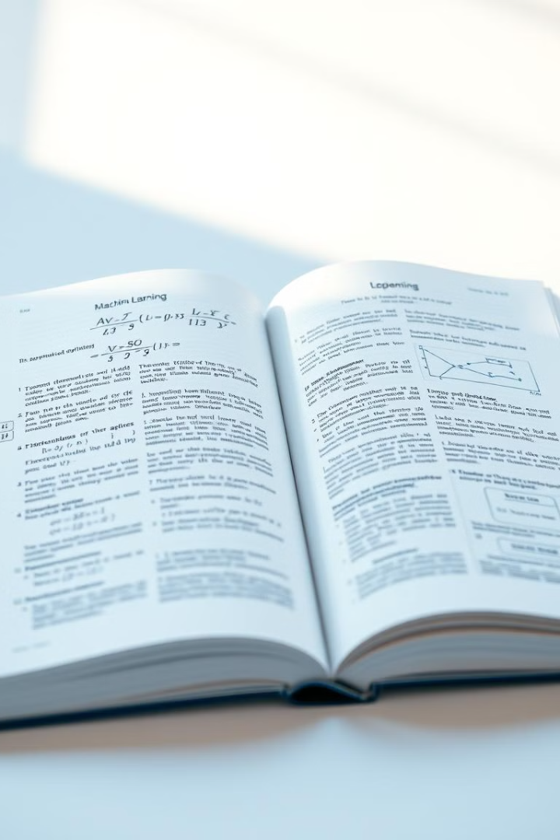
What is Machine Learning?
1
Data-Driven Approach
2
Automated Improvement
Machine learning relies on patterns in data to build models and make predictions, rather than following pre-programmed rules.
Machine learning algorithms can automatically adapt and enhance their performance as they are exposed to more data.
3
Wide Applications
From image recognition to natural language processing, machine learning has a broad range of real-world applications.

Slide 3
Types of Machine Learning Algorithms
Supervised Learning
Unsupervised Learning
Reinforcement Learning
Algorithms that learn from labeled training data to make predictions on new, unseen data.
Algorithms that discover patterns and structure in unlabeled data without explicit guidance.
Algorithms that learn by interacting with an environment and receiving rewards or penalties.

Slide 4

Supervised Learning Algorithms
Decision Trees
Linear Regression
Creates a tree-like model of decisions and their possible consequences.
Finds the best-fit line to predict a continuous target variable.
1
2
3
Logistic Regression
Predicts the probability of a binary target variable.

Slide 5

Unsupervised Learning Algorithms
K-Means Clustering
Principal Component Analysis
Groups data into k clusters based on similarity without labeled data.
Reduces the dimensionality of data by identifying the most important features.
Anomaly Detection
Identifies data points that are outliers or don't fit the normal patterns.

Slide 6




Reinforcement Learning Algorithms
Agent-Environment Interaction
The agent takes actions in an environment to maximize a reward signal.
Value Function Estimation
The agent learns to predict the expected future reward for each state.
Policy Optimization
The agent updates its behavior policy to select actions that lead to higher rewards.

Slide 7
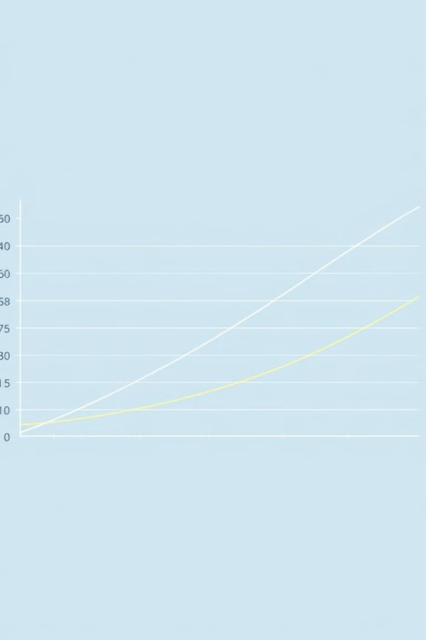
Comparison of Key Algorithms
Algorithm
Supervised/Unsupervised
Use Cases
Strengths
Weaknesses
Linear Regression
Supervised
Predicting continuous values
Simple, interpretable
Limited to linear relationships
K-Means Clustering
Unsupervised
Grouping similar data points
Fast, scalable
Sensitive to initial centroids
Decision Trees
Supervised
Classification and regression
Intuitive, handle non-linear data
Prone to overfitting

Slide 8
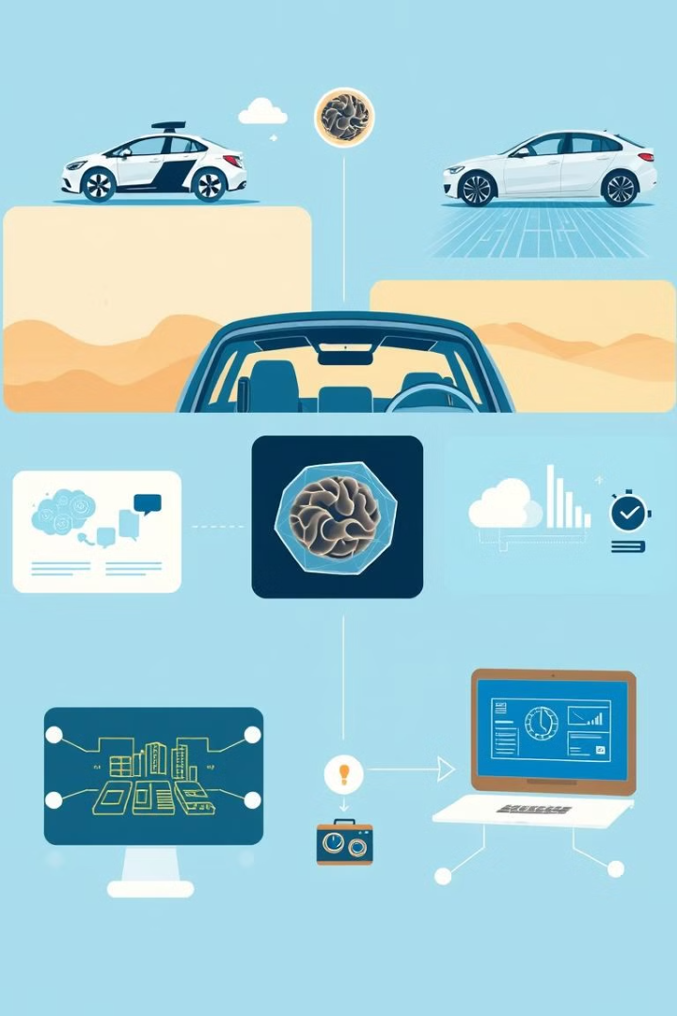



Applications and Real-World Examples
Autonomous Vehicles
Machine learning algorithms power the perception, prediction, and control systems in self-driving cars.
Healthcare Diagnostics
Machine learning helps analyze medical images and data to assist in early disease detection and diagnosis.
Personalized Recommendations
Algorithms learn user preferences to suggest relevant products, content, and services.

